Slide 1



Building Beautiful Apps using
Google Flutter
By
Ahmed Abu Eldahab
/FlutterEgypt
/FlutterEgypt

Slide 2

About Me
My name is Ahmed Abu Eldahab
I wrote my first line of code 22 years ago.
I have 15+ years experience with software (Web - Mobile - Desktop)
Founder & CTO DahabIT
Founder of FlutterEgypt
/Dahabdev
/Dahabdev
/Dahabit

Slide 3

Mobile Platforms

Slide 4

Mobile Platforms

Slide 5
Mobile Platforms

Slide 6
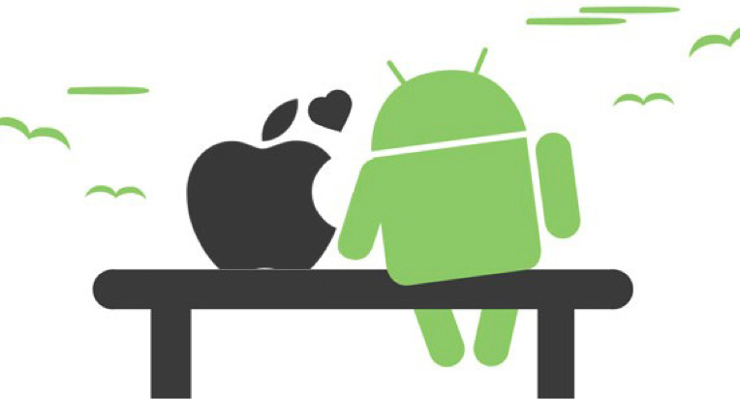
Mobile Platforms

Slide 7
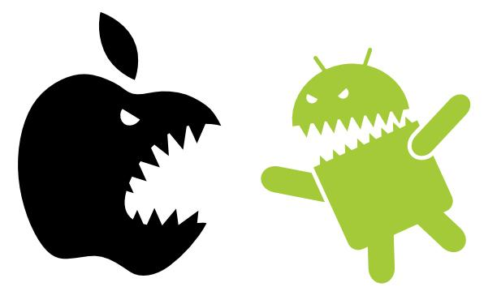
Mobile Platforms

Slide 8
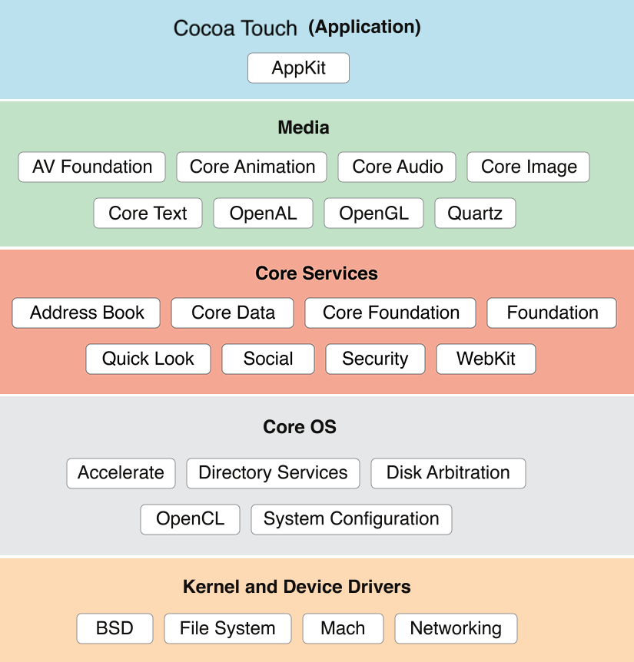
IOS
Cupertino

Slide 9
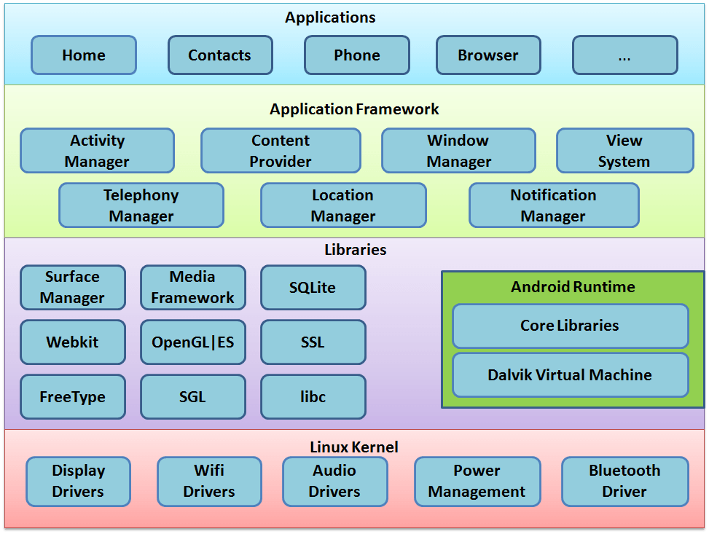
Android
Material Design

Slide 10

Mobile Development Approaches

Slide 11
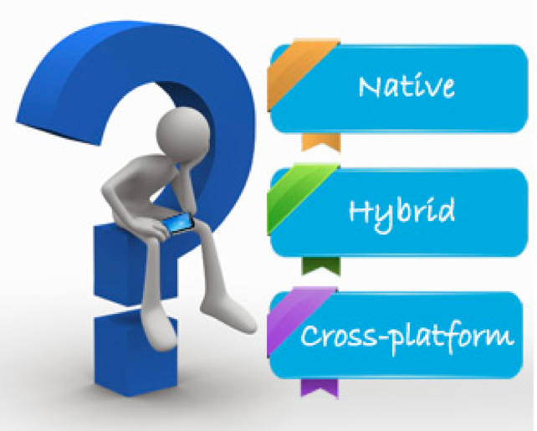
Mobile Development Approaches

Slide 12



Native Approach (Single Platform)
Swift
Kotlin

Slide 13
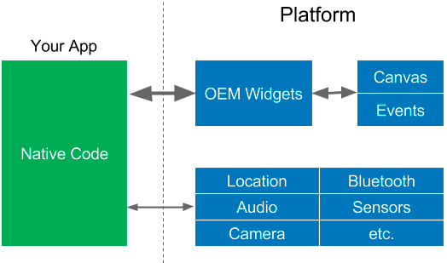
OEM SDKs

Slide 14

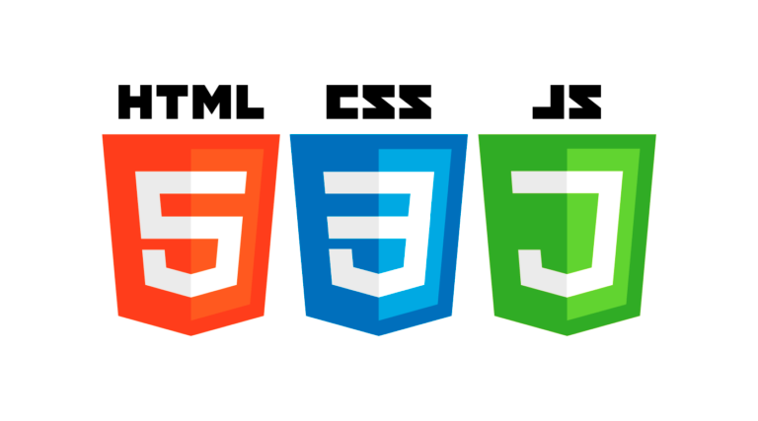


Hybrid Approach

Slide 15
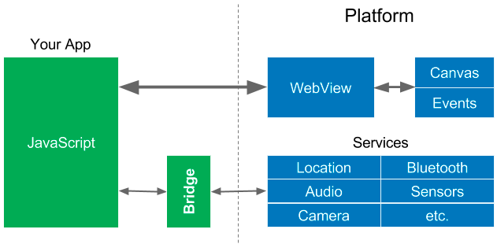
WebViews

Slide 16


Cross-Platform Approach
C#
JavaScript

Slide 17
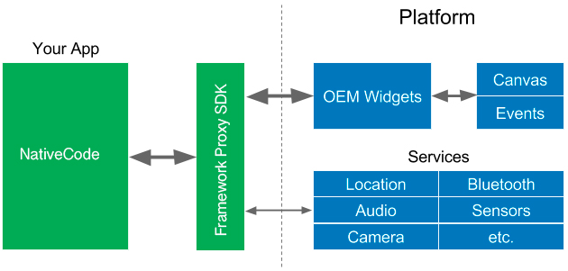
Native Proxy SDK

Slide 18


Cross-Platform Approach
JavaScript
JavaScript

Slide 19

Reactive Views

Slide 20
Mobile Development Approaches
JavaScript
C#
JavaScript
JavaScript

Slide 21

Cross-Platform Approach
Google Flutter

Slide 22
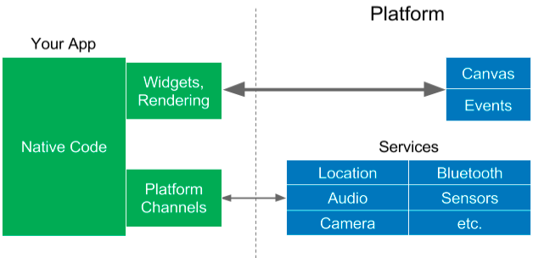
Flutter approach

Slide 23
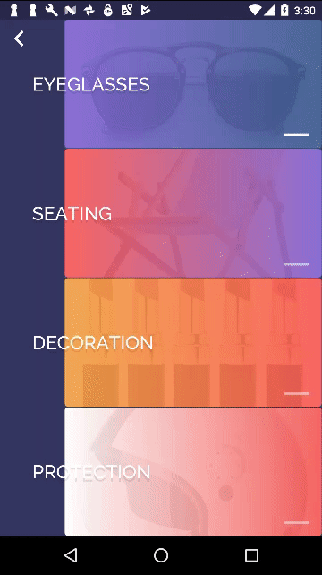


So what is Flutter ?
Flutter is the next step in
App development
Speed and performance
Fast , smooth performance
Flexibility
Customize anything
Native look and feel
Familiarity , ease of use
Rapid Development
Easy to learn , predictable

Slide 24
What makes Flutter unique?
Compiles to Native Code (ARM Binary code)
No reliance on OEM widgets
No bridge needed
Flutter

Slide 25


What language is Flutter built with?
+
=
Notes:
Make love no compiler erros

Slide 26
What is Dart?
Open-source web programming language developed by Google.
Class-based, single-inheritance, object oriented language with C-style syntax.
Supports interfaces, abstract classes, reified generics, and optional typing(Dart 1) and strong typing (Dart 2)..
One language to rule them all..

Slide 27
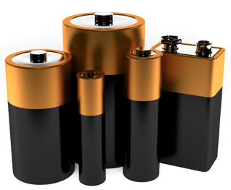
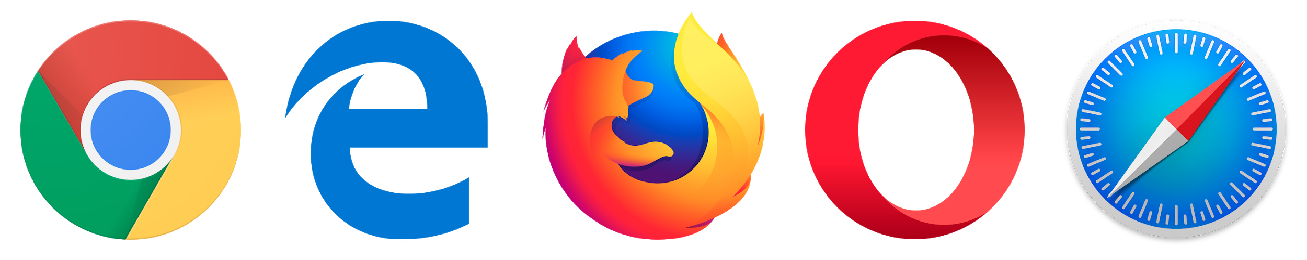
What is Dart?
Language and Libraries
Packages manager https://pub.dartlang.org/
Virtual machine
Compile to Javascript dart2js
Batteries included

Slide 28

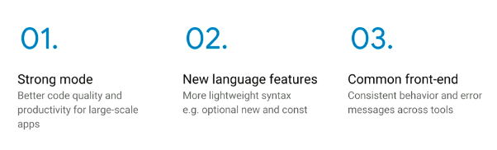
What is Dart?
Dart 2
https://www.dartlang.org/dart-2

Slide 29
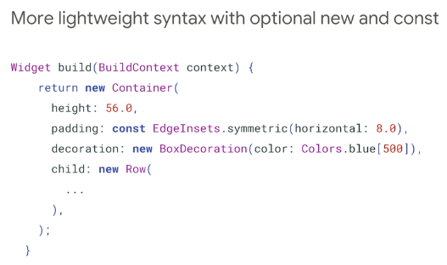
What is Dart?
https://www.dartlang.org/dart-2

Slide 30
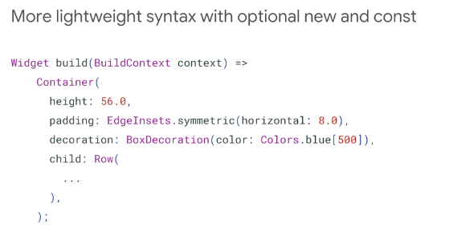
What is Dart?
https://www.dartlang.org/dart-2

Slide 31
Who use Dart?
Google AdWords
Google Fuchsia
Google Fiber
AdSense
performance reports
Mandrill
AdWords for video
Google internal sales tool
Google internal CRM
Adobe
https://www.dartlang.org/community/who-uses-dart

Slide 32

Google Fuchsia
Fuchsia is a capability-based, real-time operating system (RTOS) currently being developed by Google.
https://github.com/fuchsia-mirror/

Slide 33
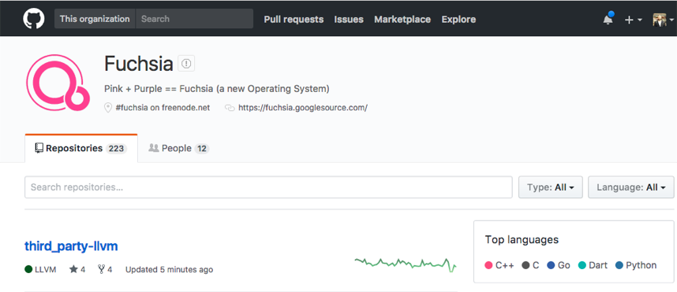

Google Fuchsia
https://github.com/fuchsia-mirror/

Slide 34
How Flutter works ?
Flutter

Slide 35
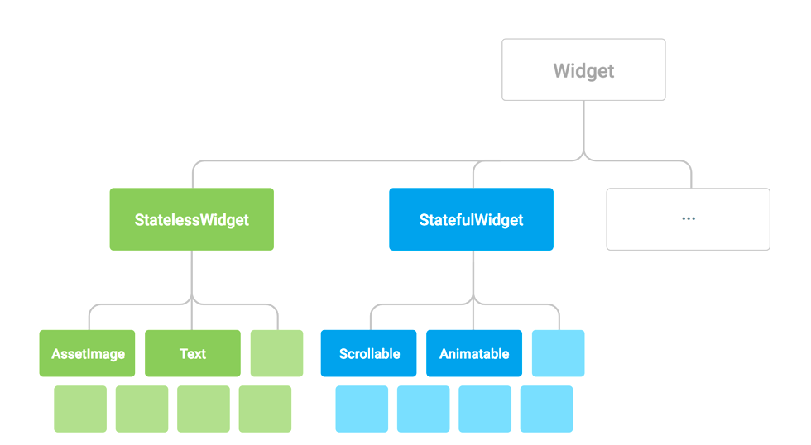
Everything is a Widget
Notes:
Every thig is a widget , we mean everyting you coffe cup , , your keyboard is a widget, your dog

Slide 36
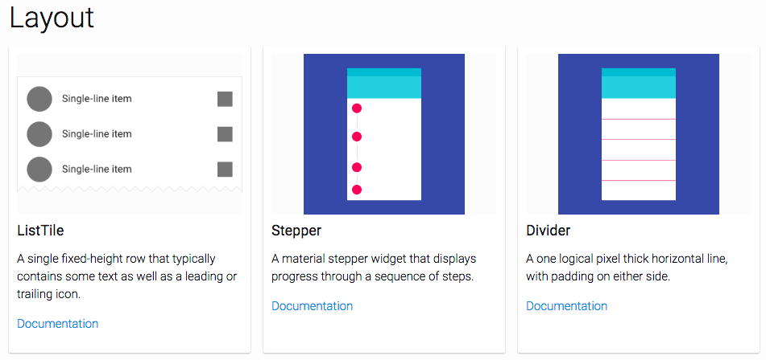
https://flutter.io/widgets/widgetindex/

Slide 37
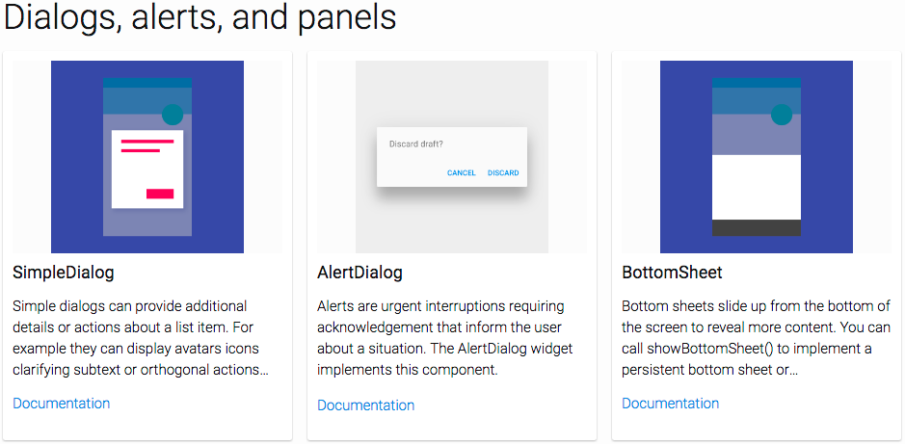
https://flutter.io/widgets/widgetindex/

Slide 38
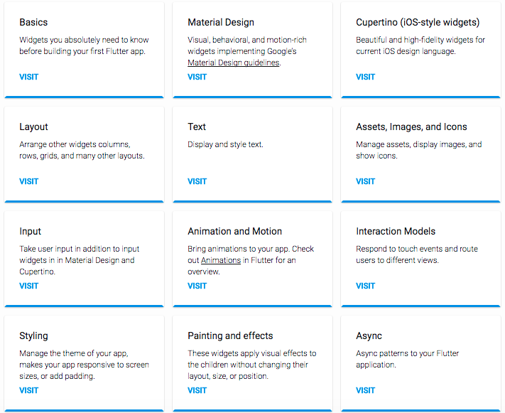
https://flutter.io/widgets/

Slide 39
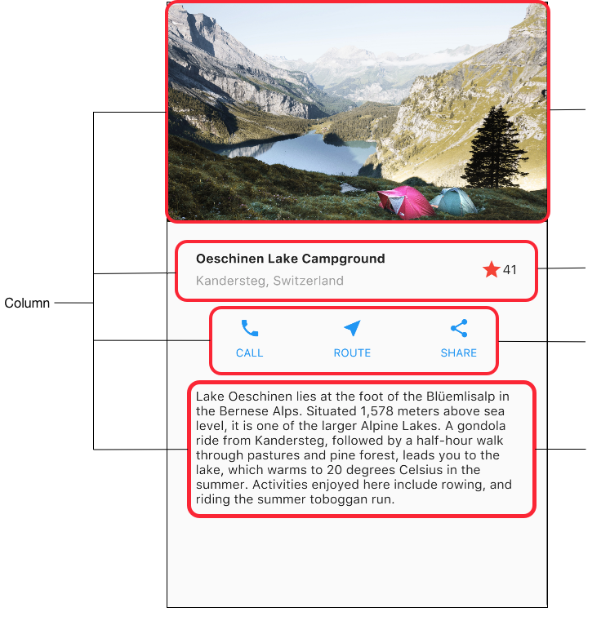
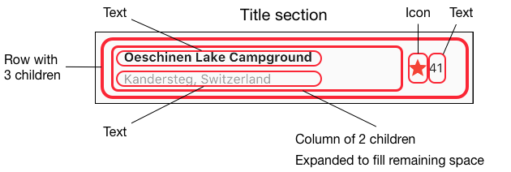
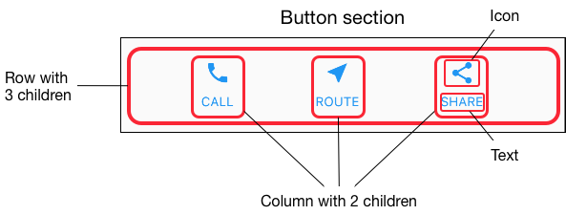
Rows and columns

Slide 40
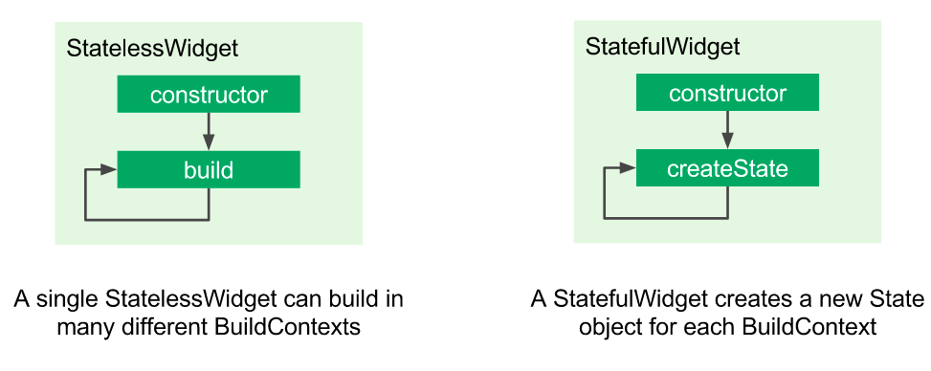
StatefulWidget vs. StatelessWidget

Slide 41
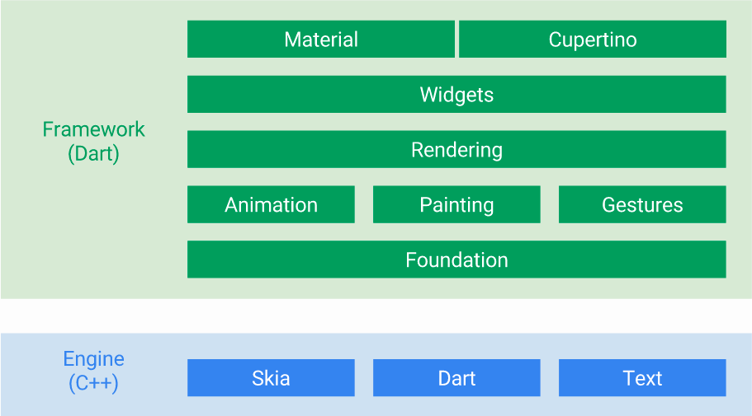
You Can customize everything in green

Slide 42
Flutter

Slide 43
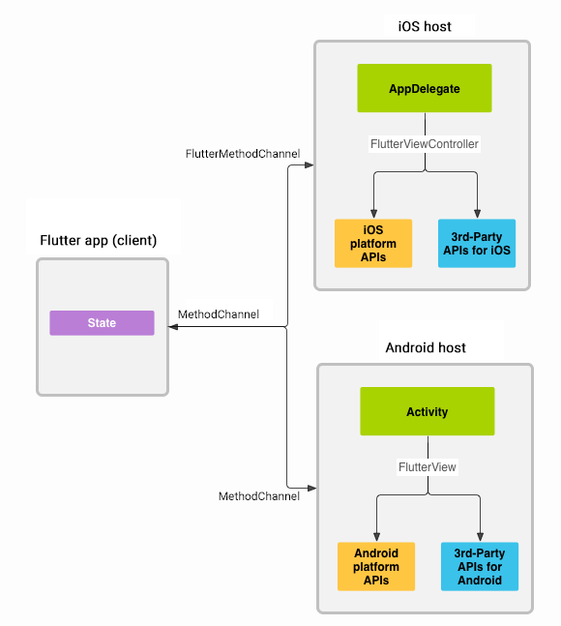
Platform channels
Flutter
https://flutter.io/platform-channels/

Slide 44
What’s make Flutter unique ?
Flutter

Slide 45
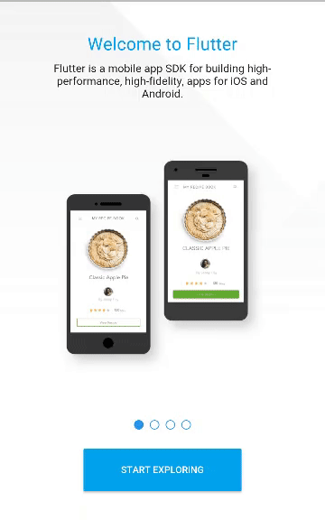
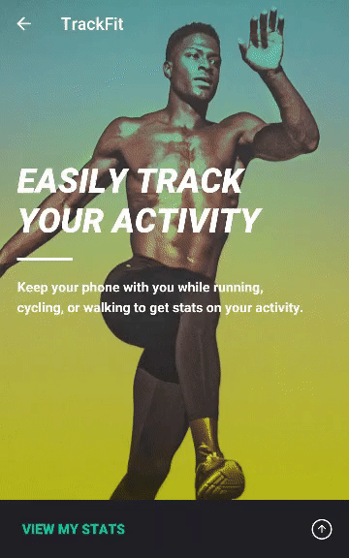
Great looking and fast Widgets

Slide 46
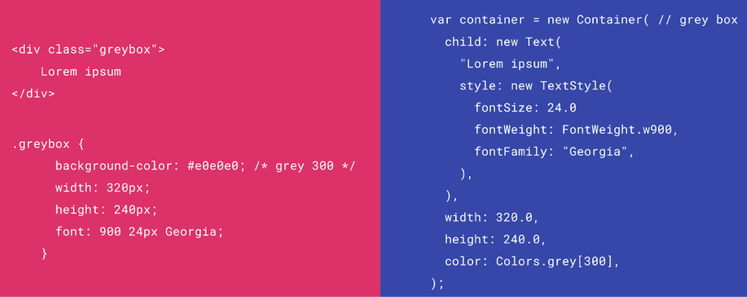
HTML/CSS Analogs in Flutter

Slide 47
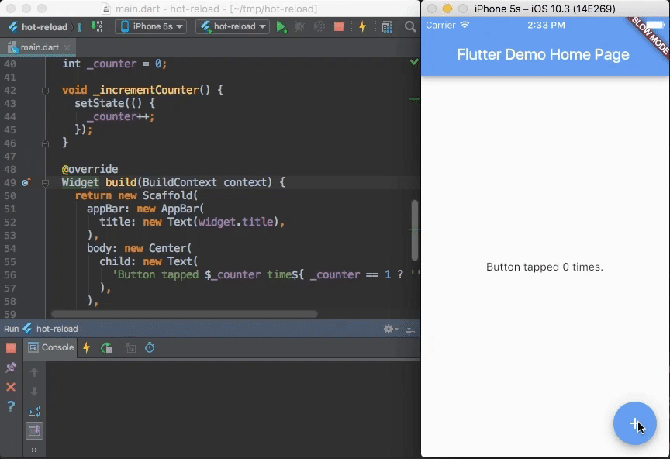
Hot Reload

Slide 48
With Flutter no limit to your imagination.
Flutter

Slide 49
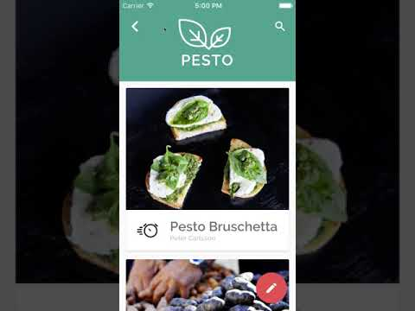
With Flutter no limit to your imagination.

Slide 50
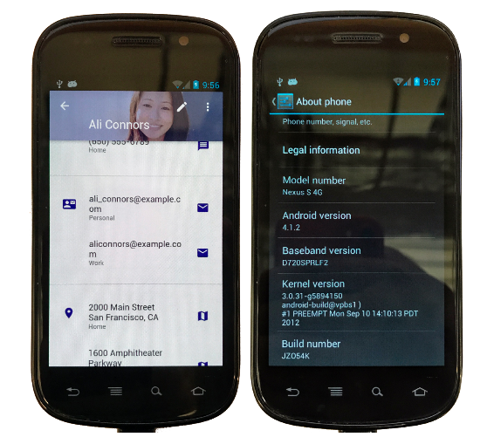
Consistent Material Design (or your design) on phones made way before Material Design existed

Slide 51





IDE Support ?

Slide 52
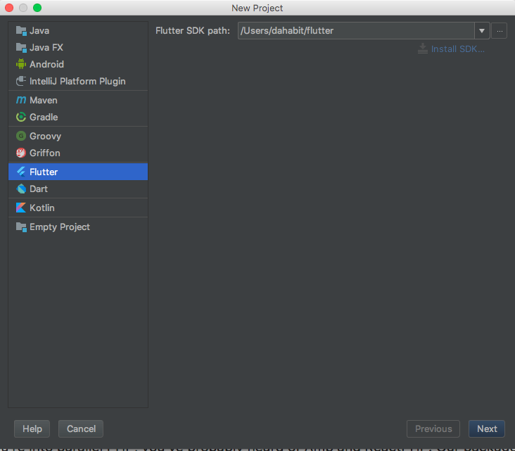
IDE Support ?

Slide 53
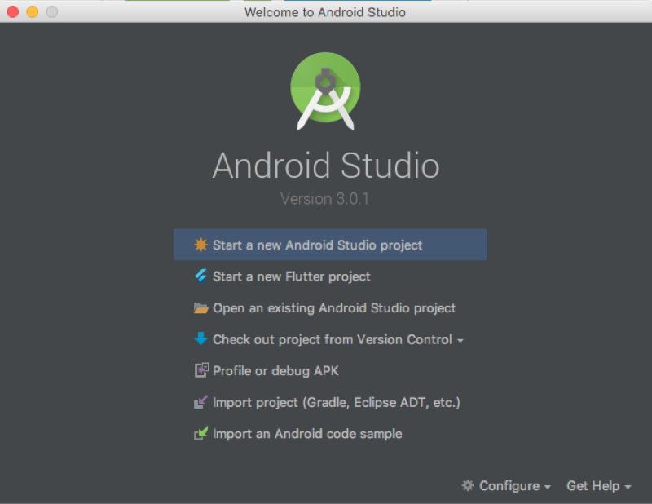
IDE Support ?

Slide 54
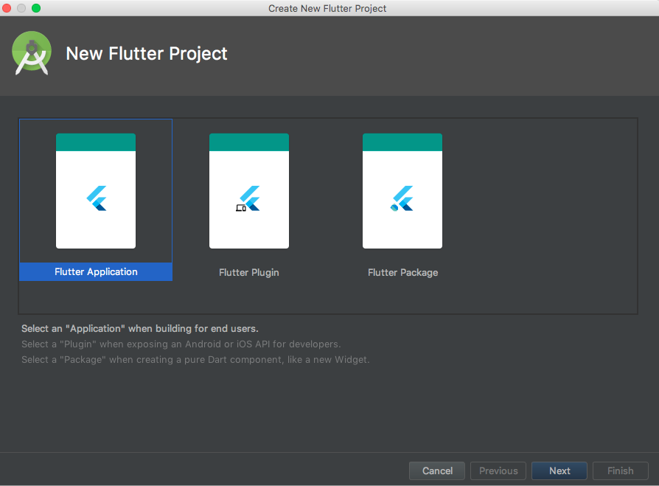
IDE Support ?

Slide 55
IDE Support ?

Slide 56
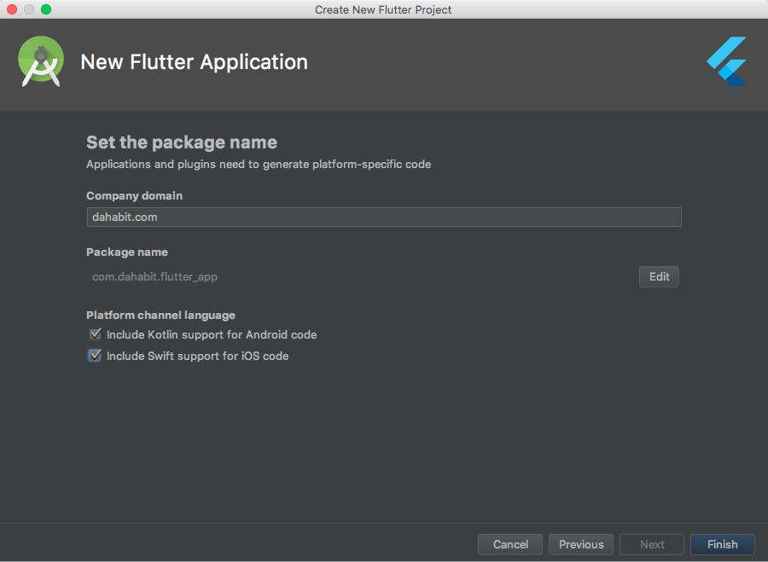
IDE Support ?

Slide 57
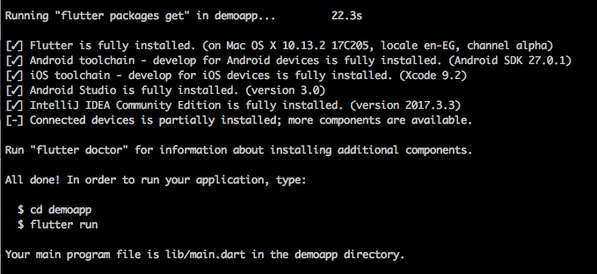
Terminal ?
$ flutter create demoapp

Slide 58
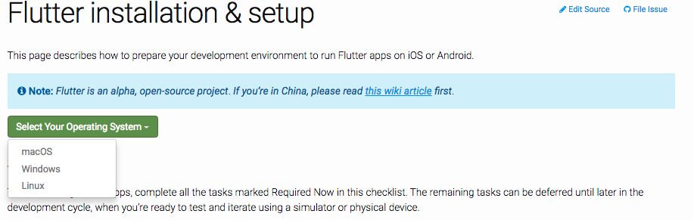
How To install ?
https://flutter.io/setup/

Slide 59
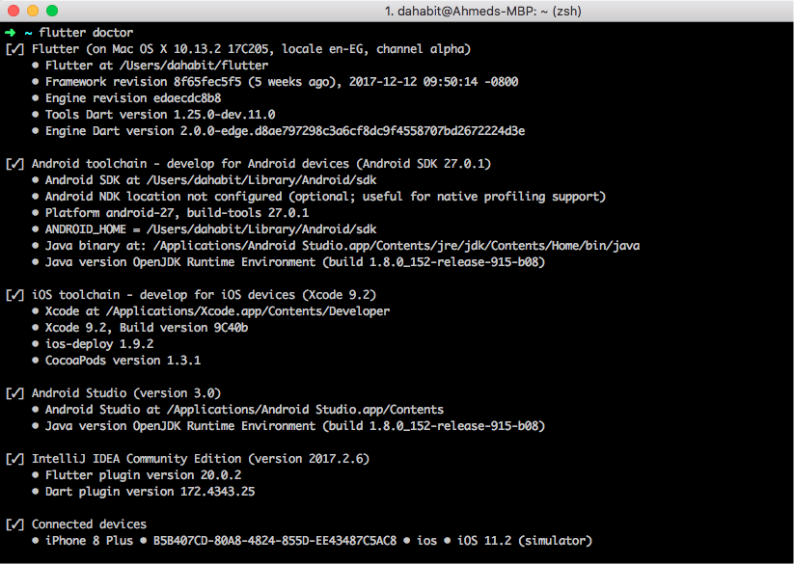
Easy Check !
$ flutter doctor

Slide 60
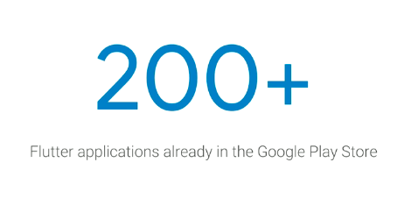

Slide 61
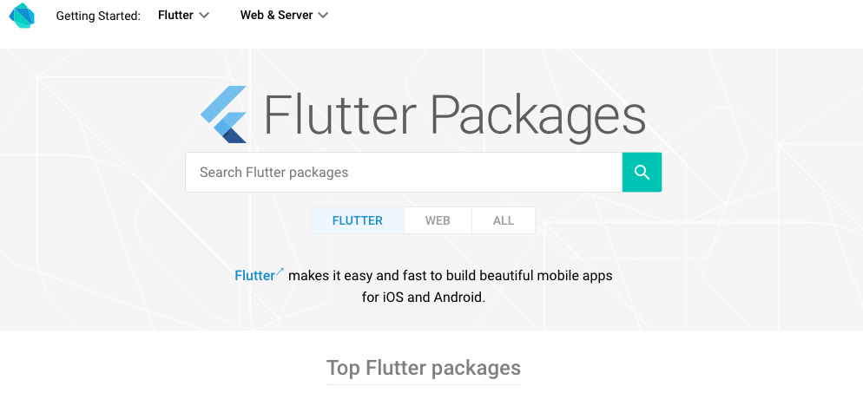
https://pub.dartlang.org/flutter

Slide 62
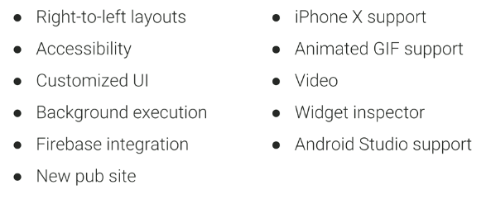
What's happening now ?
Flutter currently is in Alpha

Slide 63
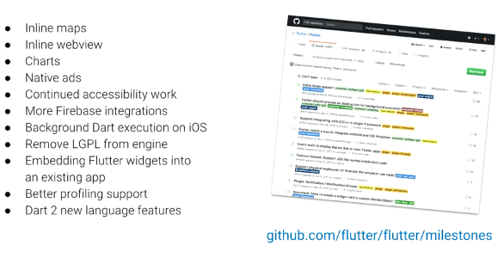
What next ?

Slide 64
Mobile Development Approaches
Google Flutter
Dart
JavaScript
C#
JavaScript
JavaScript

Slide 65
Demo

Slide 66
Question?

Slide 67
Building Beautiful Apps using
Google Flutter
By
Ahmed Abu Eldahab
/FlutterEgypt
/FlutterEgypt

